Slide 1
Data Manipulation with Pandas
PANDAS

Slide 2
Data Manipulation with Pandas
Introducing Pandas Objects
Data indexing and Selection
Operating on Data in Pandas
Handling Missing Data
Hierarchical Indexing
Combining Datasets: Concat and Append
Combining Datasets: Merge and Join
Aggregation and Grouping
Pivot Tables
Visualize data with pandas

Slide 3
Introducing Pandas Objects
What is Pandas?
A Python library for data analysis
Supports powerful data structures and operations
Pandas objects can be thought of as enhanced versions of NumPy structured arrays in which the rows and columns are identified with labels rather than simple integer indices.
Import:
import numpy as np
import pandas as pd

Slide 4
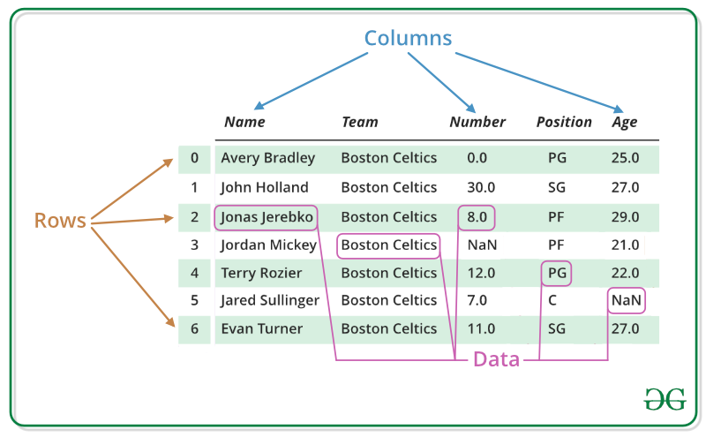
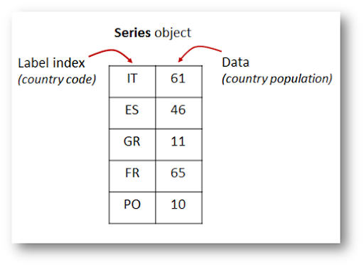
Introducing Pandas Objects
Series Object
1-dimensional array of indexed data
DataFrame Object
2-dimensional table with named columns and indexed rows
Attributes:
Series.index
Series.values
DataFrame.index DataFrame.columns
DataFrame.values

Slide 5
Introducing Pandas Objects
Creating Series: pd.Series()
From a list: series1 = pd.Series([1,2], index = ['a', 'b'])
From a dict: series2 = pd.Series({"a":1,'b':2})
Creating DataFrame: pd.DataFrame()
From a adict:
df1 = pd.DataFrame({'state': ['Ohio','CA’],
'year': [2000, 2010]})
df2 = pd.DataFrame({'col1': {'row1': 1,'row2': 2},
'col2': {'row1':3, 'row2': 4}})
From a two-dimensional NumPy array
df3 = pd.DataFrame(np.random.rand(3, 2),
columns=['foo', 'bar’],
index=['a', 'b', 'c'])

Slide 6
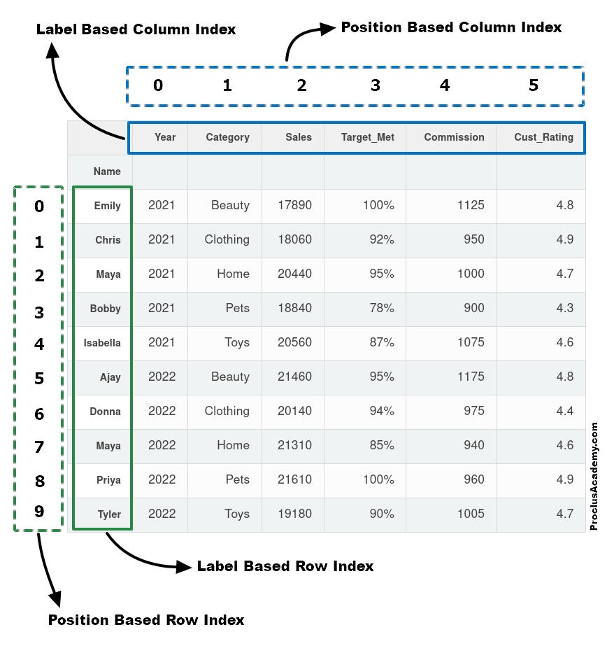
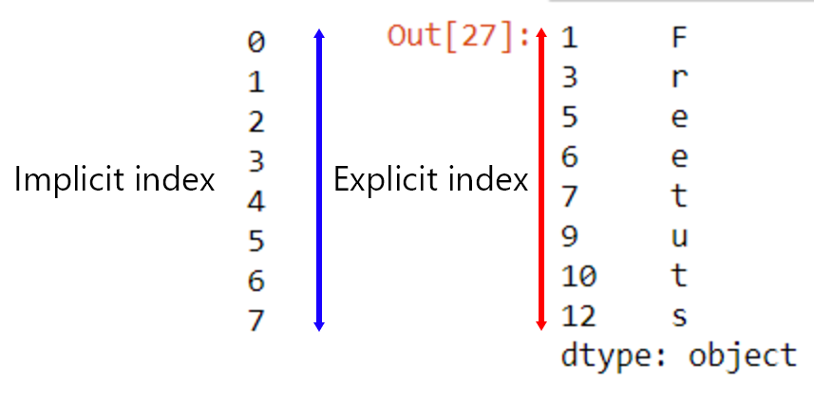
Introducing Pandas Objects
Implicit – Explicit Index

Slide 7


Data indexing and Selection
Data Selection in Series
s1 = pd.Series(range(10,14), index=list("abcd"))
Implicit integer index
Series as dictionary: s1.keys(); s1.values; s1.items()
Series as one-dimensional array:
Indexers: loc and iloc: s1.loc['b’]; s1.iloc[1]

Slide 8
Data indexing and Selection
Data Selection in DataFrame
area = pd.Series({'California': 423967, 'Texas': 695662,
'Florida': 170312, 'New York': 141297,
'Pennsylvania': 119280})
pop = pd.Series({'California': 39538223, 'Texas': 29145505,
'Florida': 21538187, 'New York': 20201249,
'Pennsylvania': 13002700})
data = pd.DataFrame({'area':area, 'pop':pop})
DataFrame as a dictionary:
data['area’] ; data.area
data['density'] = data['pop'] / data['area']
DataFrame as two-dimensional array:
Single “index” refers to column: data['area’]
Two “index”: data.loc['Florida', 'pop’], data.iloc[3,2]
Slicing refers to rows (one ‘index’): data['Florida':'New York’]
data.loc[:'Florida', :'pop’] ; data.iloc[:3, :2]

Slide 9
Operating on Data in Pandas
Index Preservation
These operations preserve the index and column labels in the output.
rng = np.random.default_rng(42)
ser = pd.Series(rng.integers(0, 10, 4))
df = pd.DataFrame(rng.integers(0, 10, (3, 4)),columns=['A', 'B', 'C', 'D'])
np.exp(ser)
np.sin(df * np.pi / 4)
Index Alignment
Pandas automatically aligns indices.
area = pd.Series({'Alaska': 1723337, 'Texas': 695662, 'California': 423967}, name='area')
population = pd.Series({'California': 39538223, 'Texas': 29145505, 'Florida': 21538187}, name='population')
population / area

Slide 10
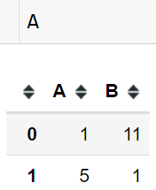
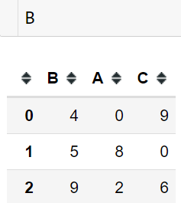
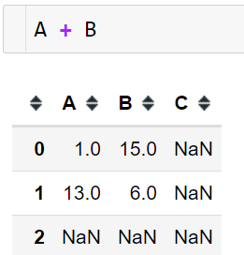
Operating on Data in Pandas
Operations Between DataFrames and Series

Slide 11
Add and Remove row or columns
Adding
Columns: df['new_columns'] = col_val
Rows: df.loc[new_index] = row_val
df.append(new_row)
Remove
Columns: df.drop(column =["drop_col"],inplace = True)
del df["drop_col"]
Row: df.drop(index = ind_drop)
Practice
df = pd.DataFrame({
'A': [1, 2, 3],
'B': [4, 5, 6],
'C': [7, 8, 9]})

Slide 12
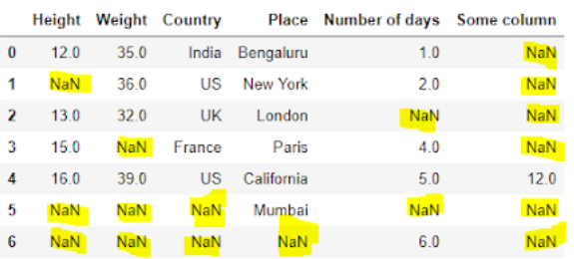
Handling Missing Data
Handling Missing Data in Pandas
Real-world data is often messy and inconsistent.
Handling missing data is crucial for working with real-world datasets.
How is a Missing Value Represented in a Dataset?
Some common representations:
NaN (Not a Number)
NULL or None:
Empty Strings
Special Indicators: Datasets might use specific indicators like -999, 9999….
Blanks or Spaces

Slide 13
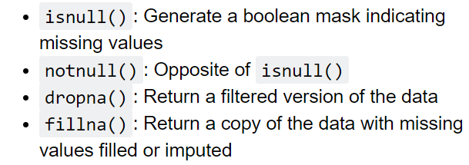
Handling Missing Data
How to Handle Missing Data?
Detcecting
Handling
isnull()
Dropping
Filling

Slide 14
Handling Missing Data
Detecting Missing Values:
df.isnull()
Handling Missing Values:
Dropping Missing Values:
DataFrame.dropna(axis=0, how=default, thresh=default, ...)
Drop Duplicate: df.drop_duplicates()
Practice
data = {'Name': ['John', 'Anna', 'Peter', 'Linda', 'James'],
'Age': [28, 22, np.nan, 32, 25],
'City': ['New York', 'Paris', 'Berlin', np.nan, 'London'],
'Salary': [70000, np.nan, 60000, 85000, np.nan]}
df = pd.DataFrame(data)

Slide 15
Handling Missing Data
Filling Missing Values:
DataFrame.fillna(value=None, method=None, axis=None, inplace=False,…)
Values: calar, dict, …mean, median
Method: {‘bfill’, ‘ffill’, None}, default None
ffill: propagate last valid observation forward to next valid.
bfill: use next valid observation to fill gap.
Filling Missing Values by base model

Slide 16
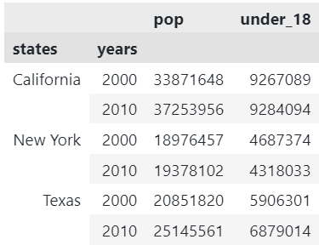
MultiIndex – Hierachical Indexing
MultiIndex in pandas allows for the creation of hierarchical indexes, making it easier to manage and analyze complex data.
It is useful for working with hierarchical data and performing complex group operations.
MultiIndex can be used for both rows and columns
MultiIndex

Slide 17
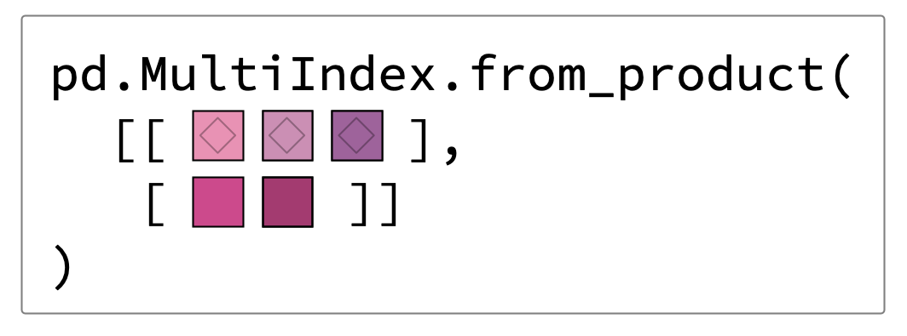
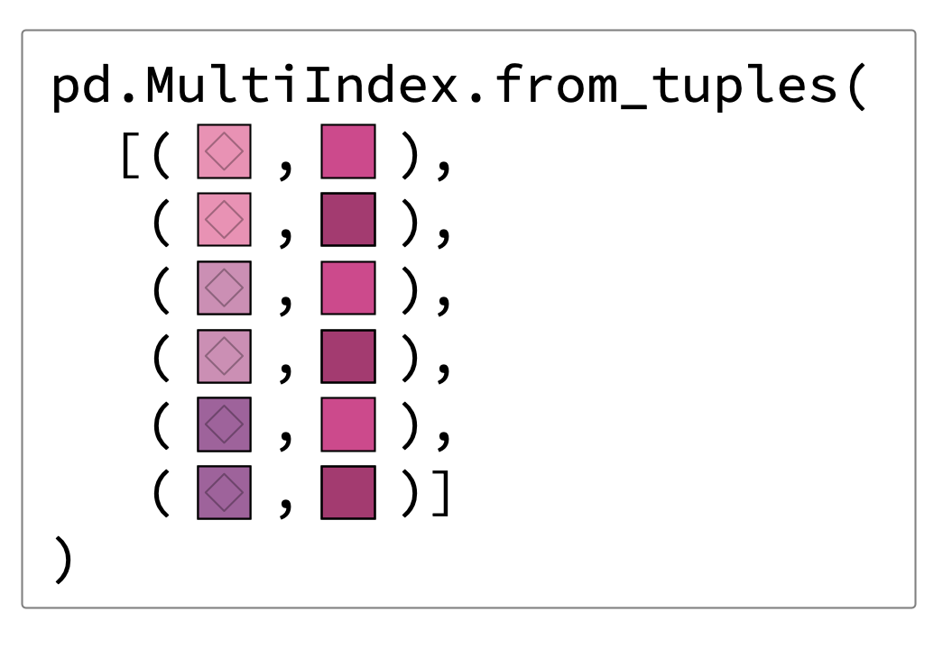
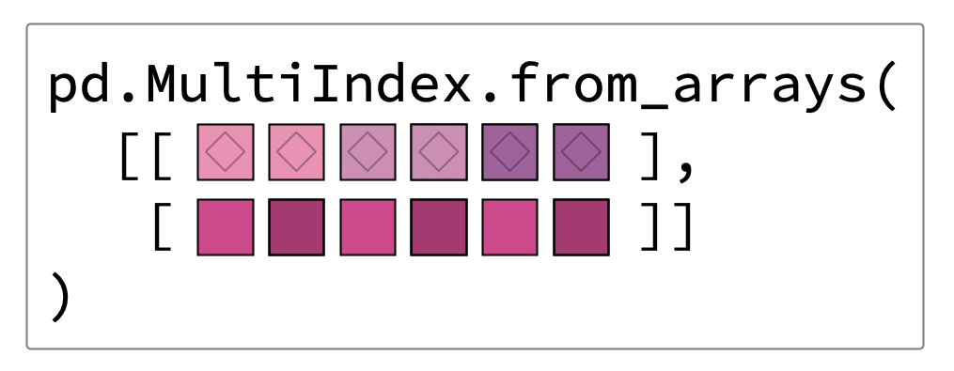
MultiIndex – Hierachical Indexing
Creating a MultiIndex

Slide 18
MultiIndex - Hierarchical Indexing
Create a DataFrame with MultiIndex
index = [('California', 2000), ('California', 2010),
('New York', 2000), ('New York', 2010),
('Texas', 2000), ('Texas', 2010)]
populations = [33871648, 37253956, 18976457, 19378102, 20851820, 25145561]
under18= [9267089, 9284094, 4687374, 4318033,5906301, 6879014]
ind = pd.MultiIndex.from_tuples(index, names=('states','years'))
pop = pd.DataFrame({'pop':populations, 'under_18':under18}, index=ind)
Accessing and Manipulating MultiIndex
.loc[]: pop.loc['New York’]
.xs[]: pop.xs(2010,level='years')

Slide 19
MultiIndex - Hierarchical Indexing
Create a MultiIndex from columns: use ‘set_index’ method
# Step 1: Create a sample DataFrame
data = {
'Country': ['USA', 'USA', 'Canada', 'Canada'],
'State': ['California', 'New York', 'Ontario', 'Quebec'],
'City': ['Los Angeles', 'New York City', 'Toronto', 'Montreal'],
'Population': [3970000, 8419000, 2731000, 1705000]
}
df = pd.DataFrame(data)
# Step 2: Use set_index to create a MultiIndex
df_multi_index = df.set_index(['Country', 'State', 'City'])

Slide 20
Loading Data - DataFrame
Loading Data from CSV: df = pd.read_csv('file.csv')
Loading Data from Excel: df = pd.read_excel('file.xlsx')
Loading Data from a URL:
url ='https://example.com/data.csv'
df = pd.read_csv(url)
Viewing the first few rows of the DataFrame: df.head()
Viewing the structure of the DataFrame: df.info()

